Slide 1
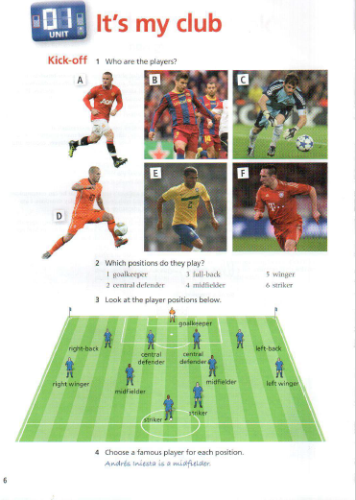
The positions of the footballers

Slide 2


